Slide 1
Twitter, News, and Stock Market Analysis
By: The Mighty Herc Mallards

Slide 2
Tech Stack
HTML, CSS, JavaScript, jQuery
MongoDB
R, Forecast, Quantmod
Python, NewsApi, Flask, TextBlob, PyMongo
Node.js, Node-nlp, Mongo, Twitter api

Slide 3
User Interface
Allowed the user to always have quick access to the navbar by making it “sticky”; used Javascript to have the navbar snap to the top of the page when scrolled past
Using :root variables in CSS and manipulating said variables in Javascript, created a night mode toggle
Using jQuery, created a smooth underline animation when hovering over a link
Using @media queries in CSS, gave the site responsive design, changing how it looks between devices of different sizes

Slide 4
Functionality
Input your choice of stock, politician, and date range then get predictions and values for your stock.
See what politicians are posting about on Twitter that could affect the flow of your stock.
Read articles about what has happened recently in the news that could change the flow of your stock.

Slide 5
Web Scraping - Twitter
Project contributions: Pull tweets from twitter using certain parameters such as username, keywords, dates, hashtags. We then conducted sentiment analysis on the data to analyze how positive and negative the subject matter is.
Implemented: Using Node.js, we implemented CLI interface and pulled data from twitter using the twit package, node-nlp to analyze the sentiment, and store our data in MongoDB
Wanted to implement sentiment for Emojis but we felt that our needs could be better used to help with other teams

Slide 6
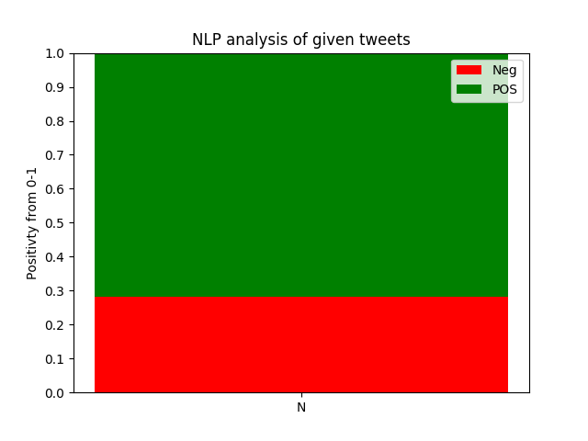

Slide 7
Statistical Analysis
Allow user to input information about a stock and receive a graph representing sentiment analysis data and current stock data within the specified time frame
Using R, takes in the Stock ID and data frame, outputs graphs to display on website of both types of sentiment and stock information
Prediction Graph is available to show how the stocks could change based on sentiments

Slide 8
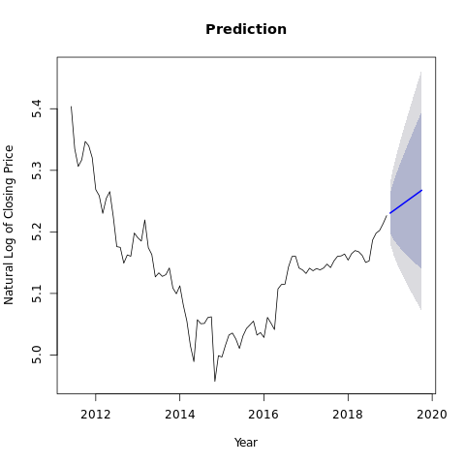
Prediction

Slide 9
Web Scraping - News
Goal - Provide sentiment analysis on data from various news sources
We pulled data from Bloomberg, New York Times, The Washington Post, and Fox News
We query the news sources based on the user’s input into our website
We then obtain a sentiment value from these articles describing how positive or negative they are
We used TextBlob, a NLP library, to obtain these values and then averaged them across all the articles, and then plotted it on a graph
Tech Stack: Used the NYT api, and NewsApi to gather the articles and Textblob to gather the sentiment values of the articles
Notes:
Project Contributions - Provided a sentiment analysis on the data that we received from various news sources. We pulled data from Bloomberg, New York Times, The Washington Post, and Fox News. We queried these news source based off the users query into the website. We then provided a sentiment value which would show how a positive or negative evaluation of the article. This was provided in the form of a graph. We did this by pulling the news source feeding the full article into the NLP algorithm and then creating an average sentiment across all articles. This was then plotted and displayed on the front end.

Slide 10
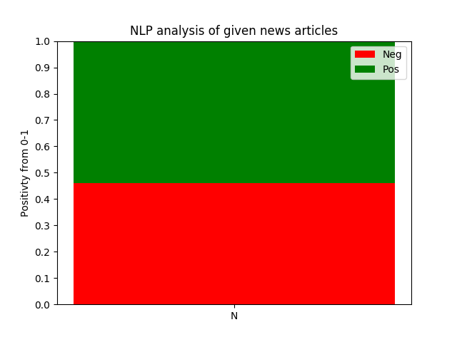

Slide 11
Backend
Project Contributions: Created the routing, database interface, and rendering of the html templates.
We did this using the Flask framework and transferred data between the different scripts through a MongoDB server
We also linked together all the scripts through the different routes on the database
We had used these routes to provide the correct user input to the different scripts across the system
After the scripts completed, we returned a response with the correct graphics that were output by these systems
We also were responsible for the AJAX calls which allowed for better User Experience so that we could asynchronously update the front end with images as they finished
Previously, we were making one HTTP request which would then return the templated version of the website. That operation took a large amount of time, and was unfeasible for production use.

